Slide 1
Diabetic Patient readmission
Pruthvinath Jeripity Venkata

Slide 2
INTRODUCTION
Problem context: Reducing readmission rates within 30 days.
Goal: Predicting how many patients are going to be readmitted within 30 days based on historical data.
Software used: Alteryx

Slide 3


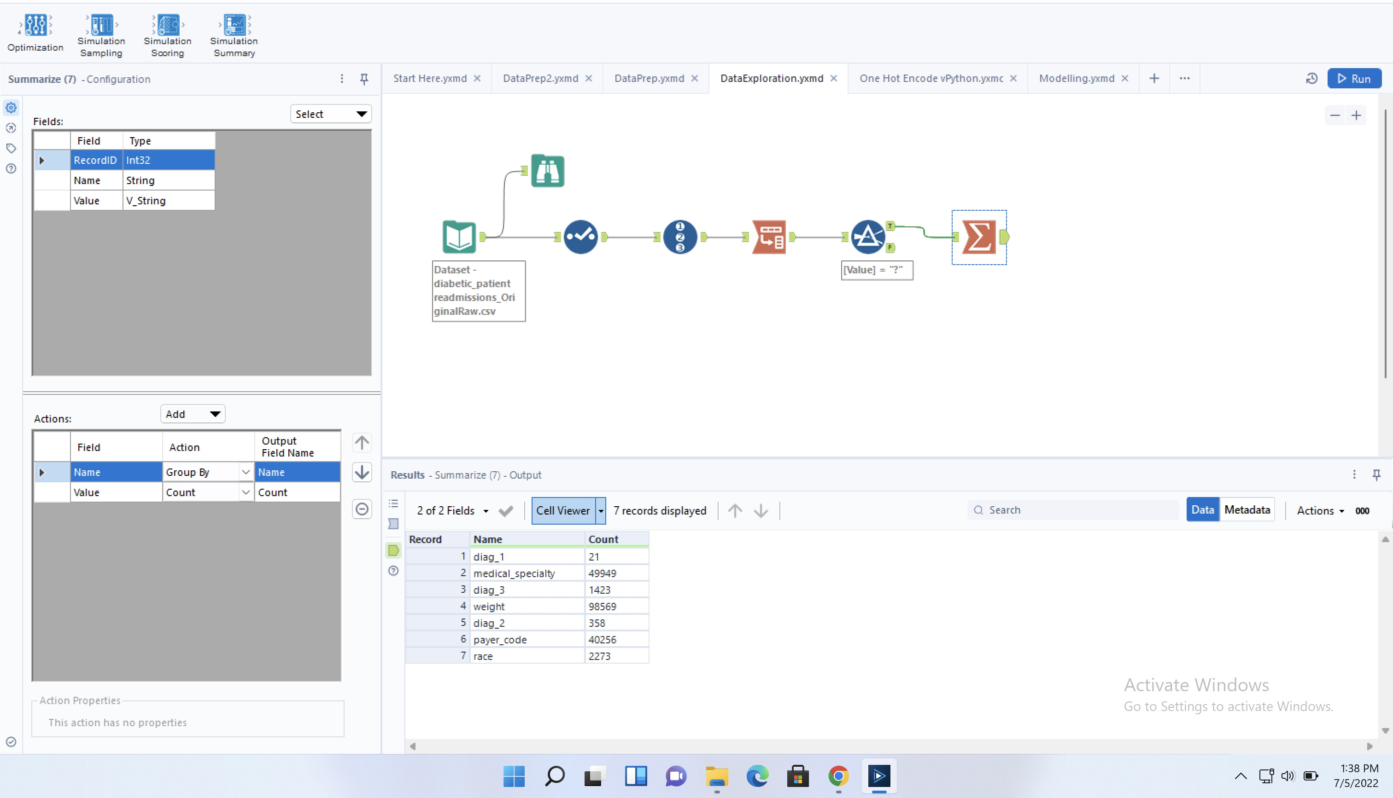

Data Exploration
To find the number of missing values in the data set:
Used TRANSPOSE to group-by column names.

Slide 4
Data Preparation
Dropped the columns which have many missing values (weight, medical specialty and payer code)
Then, dropped the rows which have missing values but not the entire columns (diag_1, diag_2, diag_3, and race)
Changed the data types of certain columns into integer (as default data type is Vstring)
Then categorized age into 3 bins
Created a new column called “Service utilization” as sum of services.
Converted readmitted column into binary

Slide 5
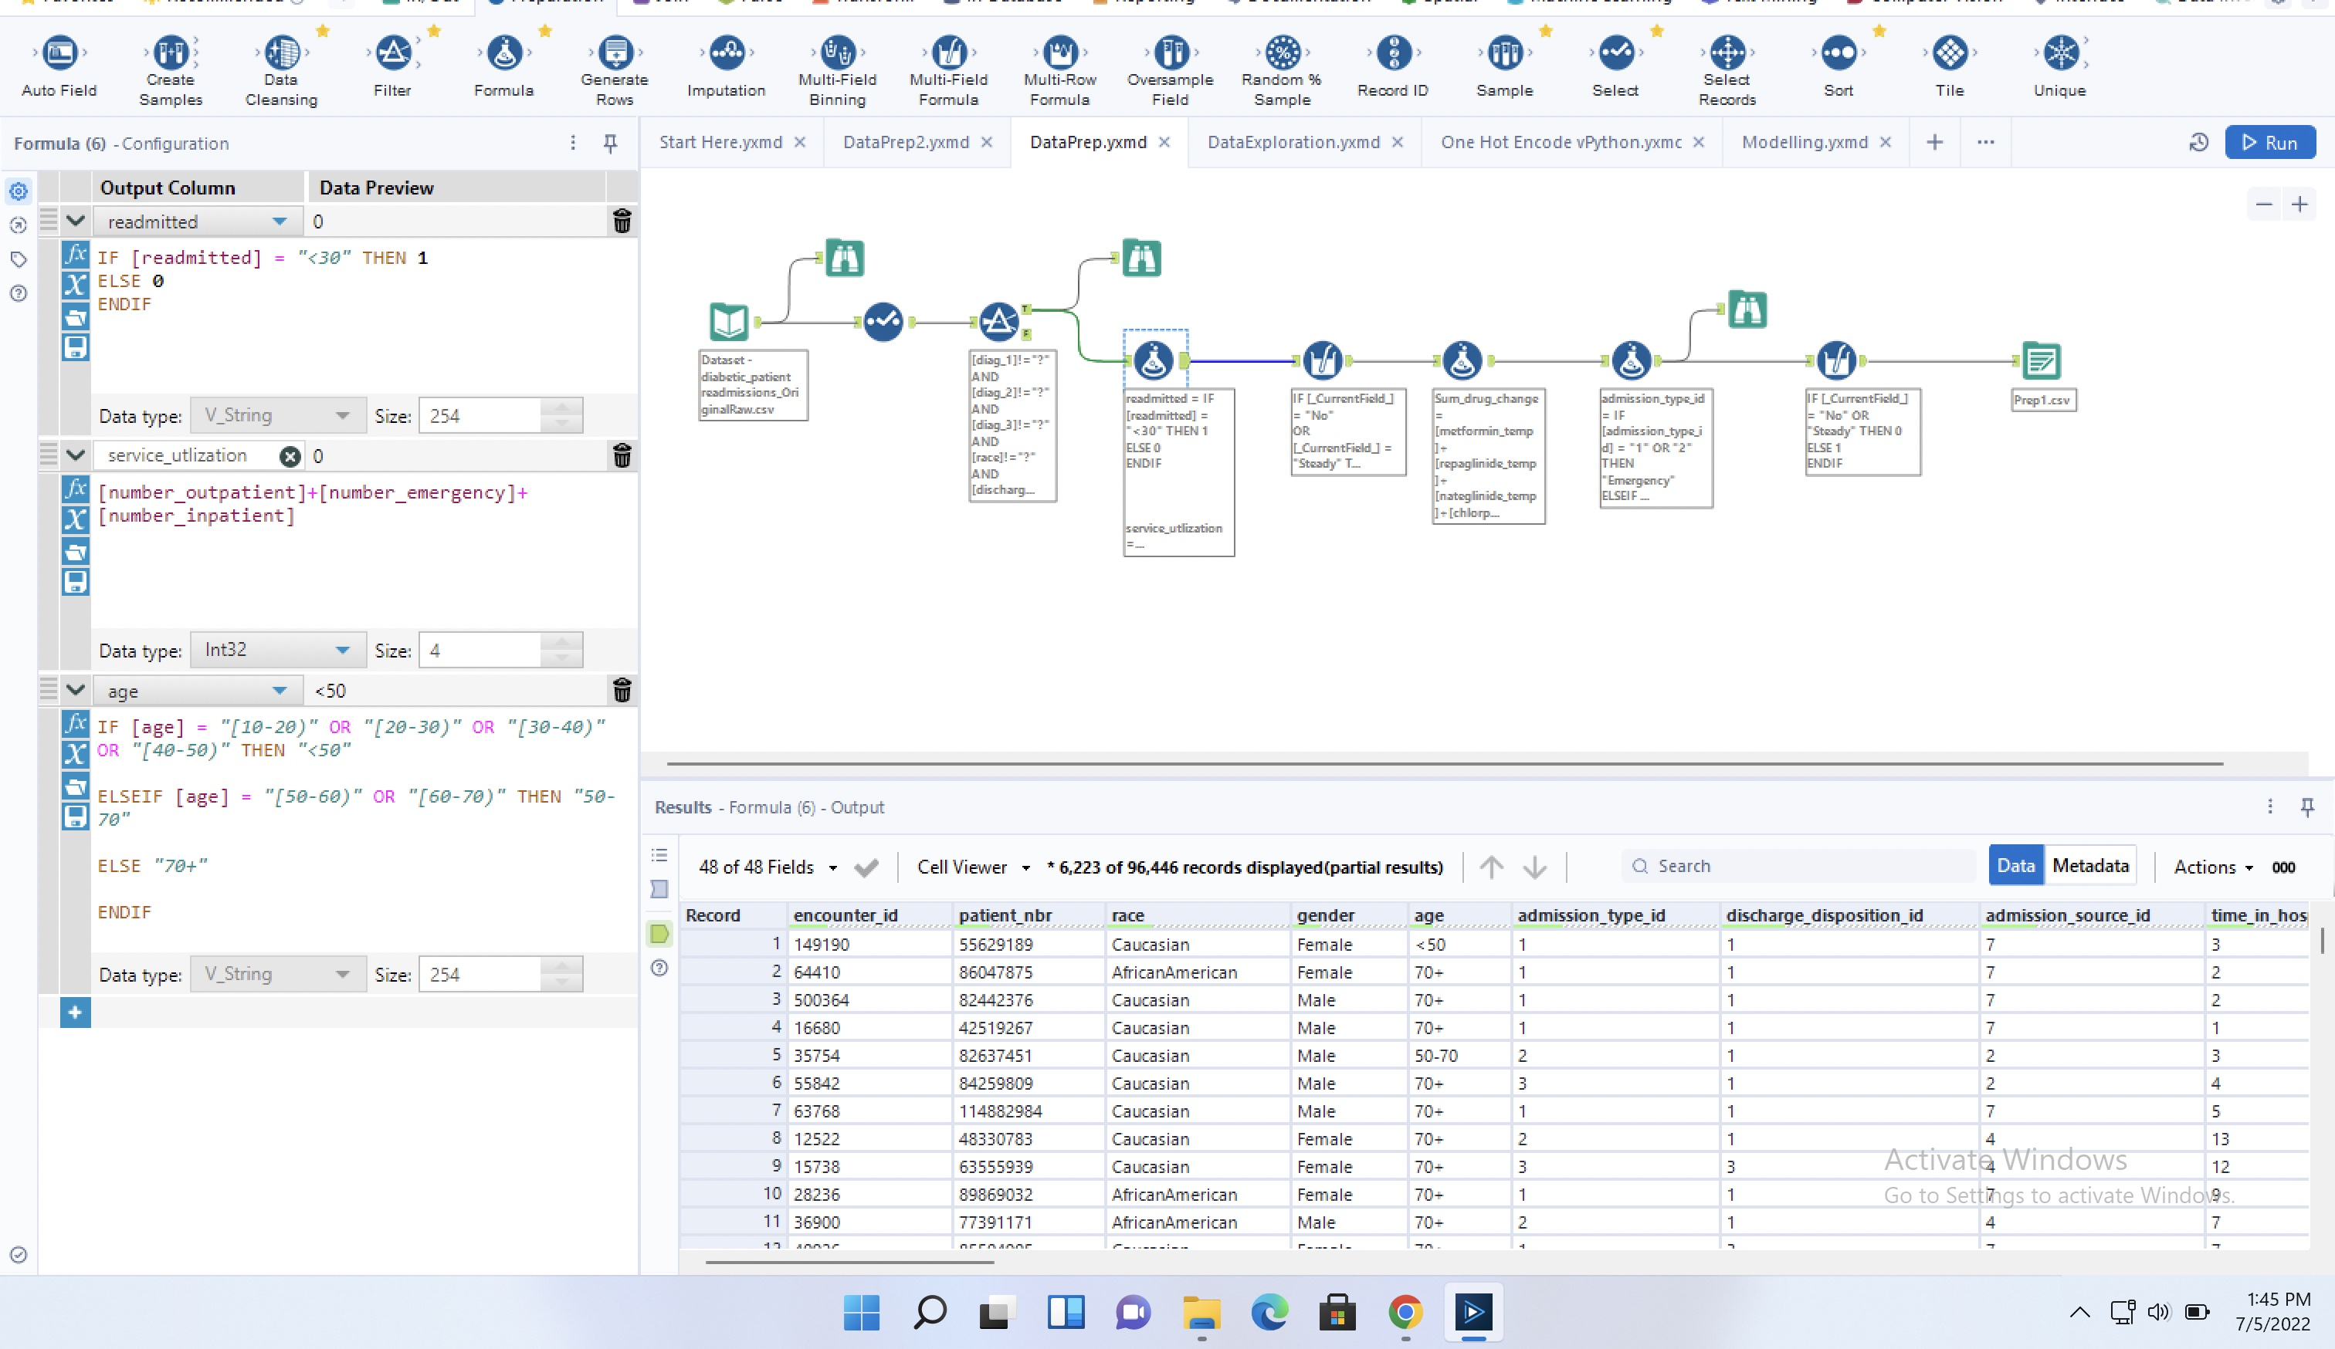

Slide 6
Then converted all the drug changes into binary.
Summed up all the drug changes for each patient => to know how many drug dosages were changed.
Then categorized the columns admission_type_id, admission_source_id, discharge_disposition_id, gender, diabetesMed, A1Cresult => logistic regression can be used in modelling.
After all data processing and cleaning, new CSV file is created.

Slide 7
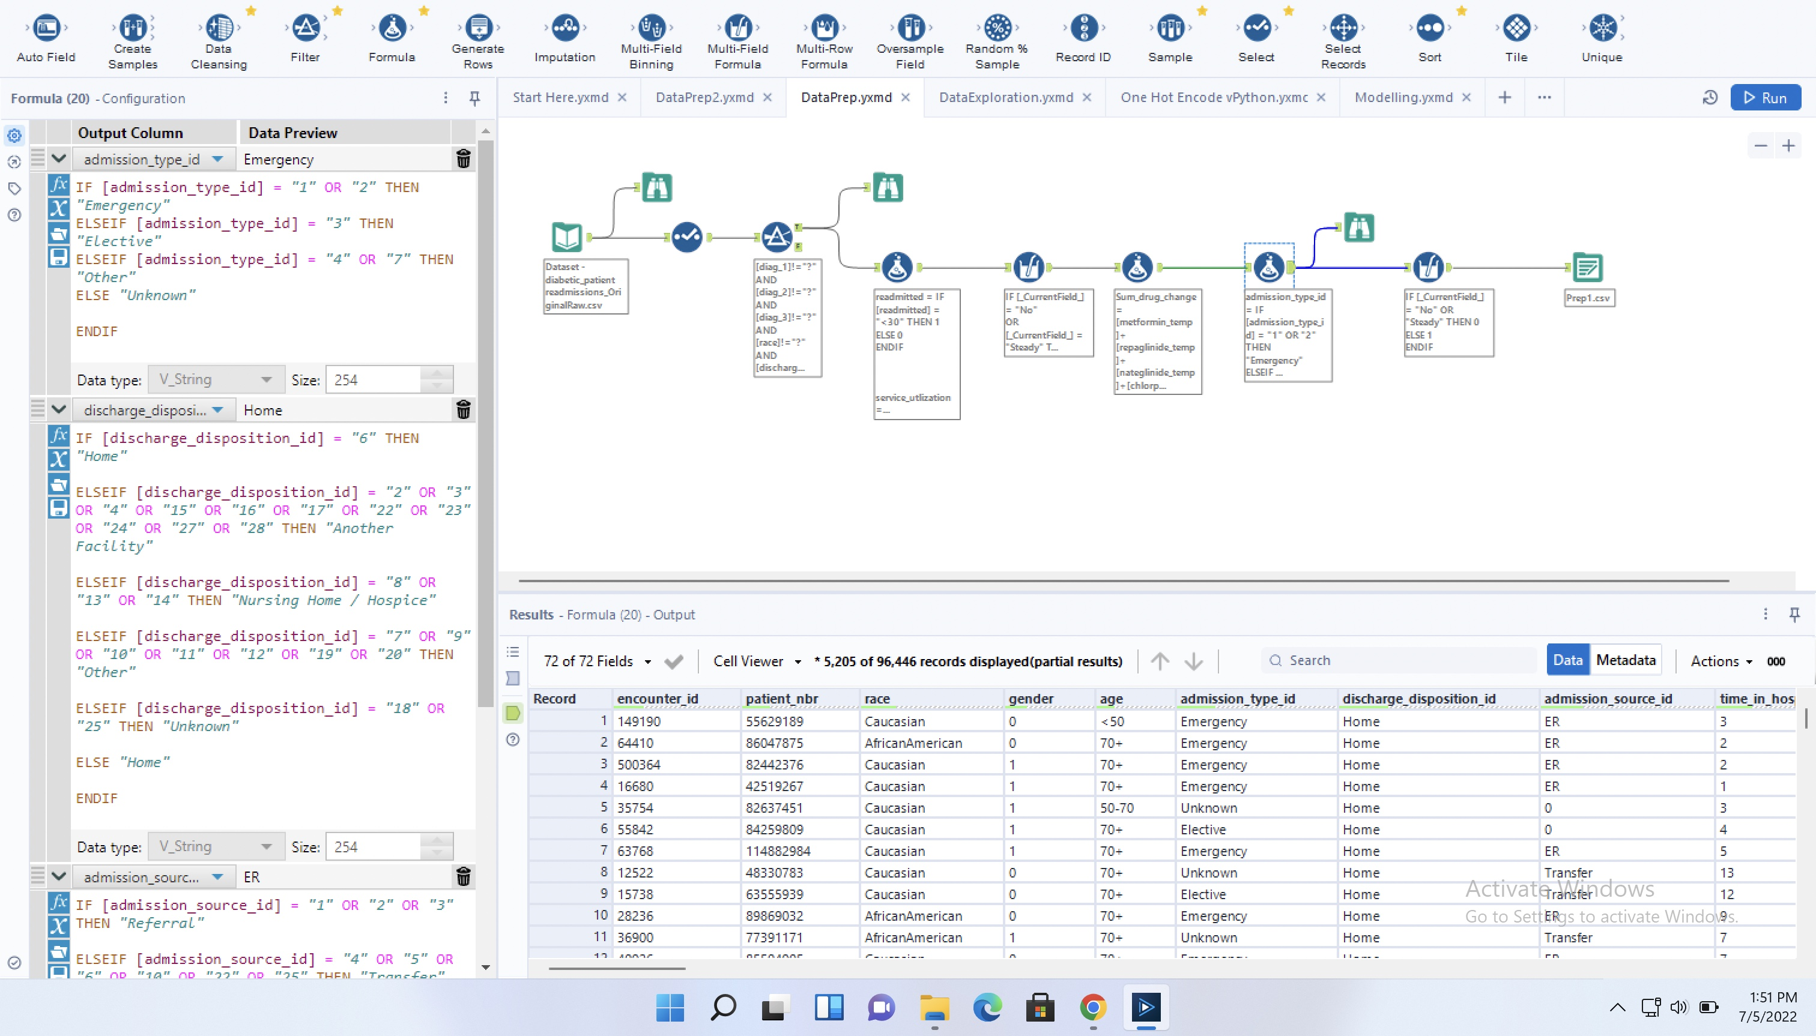

Slide 8
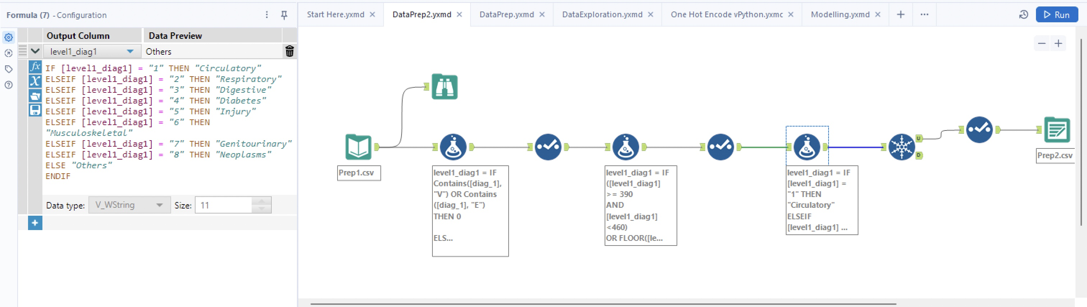
Input the CSV file, which is generated in previous step.
Further data processing is done.
Categorized level1_diag1 into 8 bins => to know the previous disease conditions of the patient.
Output as another CSV file.
Created 0, 1 vectors (dummies) (with the use of one-hot encoder) => to train the model.

Slide 9
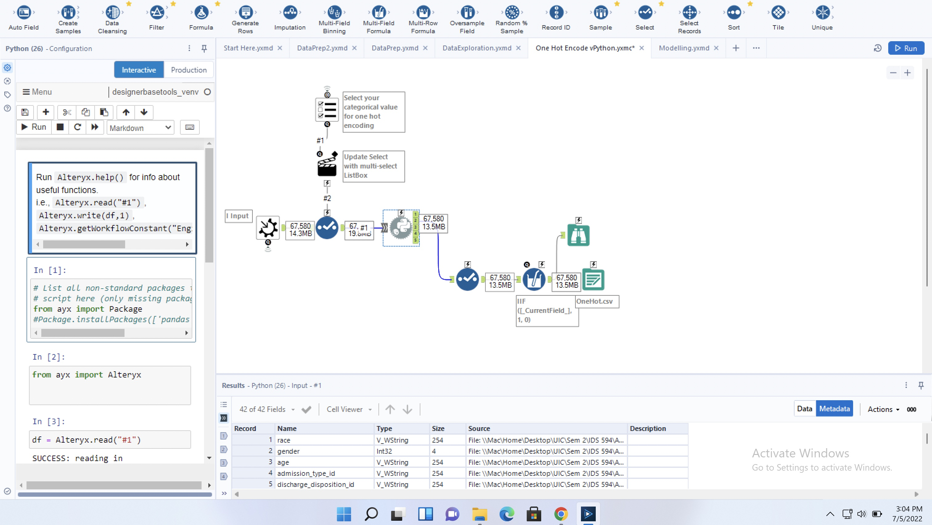

Slide 10
Modelling
With the input of one-hot encoded CSV file, we can observe that the sample is imbalanced => oversampling is done to ‘readmitted’ column
Set training sample as 80% of the data and 20% as test data.
Tried 3 models: Logistic regression, Random forest and Decision tree. (ended up with errors)

Slide 11
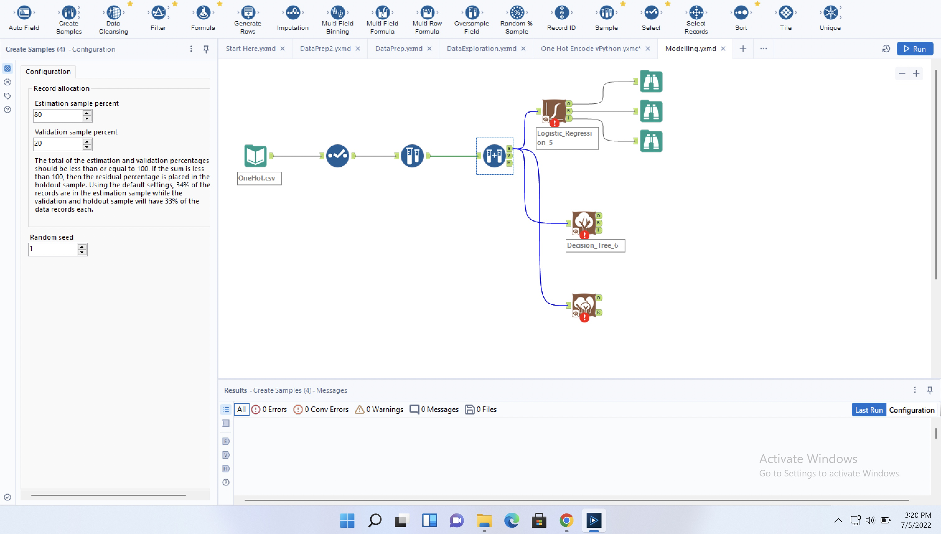

Slide 12
THANK YOU!!

